Slide 1
Lecture 21b:
5.4.2. Africa
Brad DeLong
Department of Economics & Blum Center, U.C. Berkeley; & WCEG
last revised: Th 2020-04-09
for presentation: Th 2020-04-14
Original course by Melissa Dell (Harvard Econ 1342), revised by Brad DeLong
<https://github.com/braddelong/public-files/blob/master/econ-135-lecture-21b.pptx>
<https://www.icloud.com/keynote/0xRRhkj7cn2vsAXbYKCH4E9Ug>

Slide 2
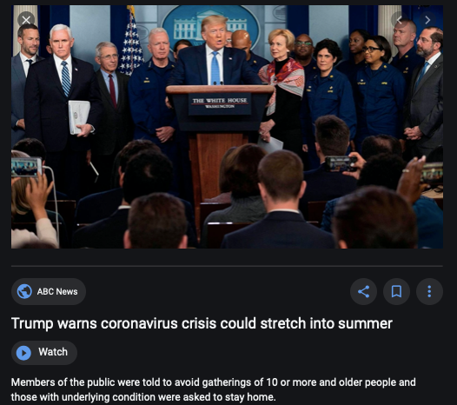
Coronavirus!

Slide 3
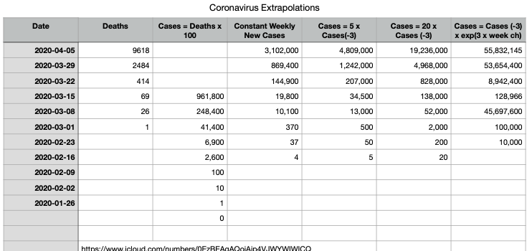
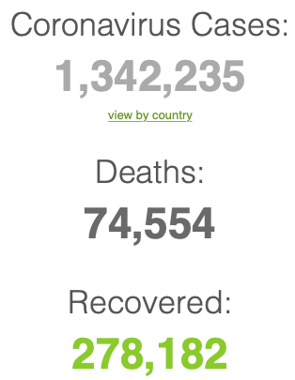
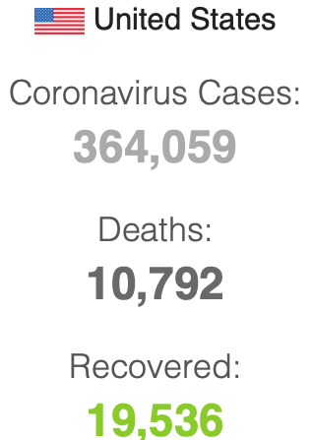
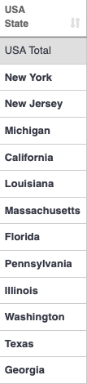
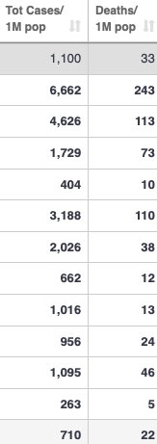
Coronavirus
Where we think we are, as of Th Apr 09:
We really do not know
No random samples…
If we extrapolate out the past week straight-line log:
We will have 440,000 deaths in three weeks
But it is unlikely to be that bad
Best thing I have read comes from Jim Stock <https://drive.google.com/file/d/12MV466ZZy5xHir4xdPhoTrL1oO8CbZU-/view>:
The basic SIR epidemiological model of contagion
The effect of social distancing and business shutdowns on epidemic dynamics enters the model through a single parameter: the case transmission rate β
Re-express the model in terms of β and the asymptomatic (or not very symptomatic) hence non-tested rate—the fraction of the infected who are not tested
The COVID-19 non-testing rate is unidentified in our model
Estimates in the epidemiological literature range from 0.18 to 0.86.
The asymptomatic rate could be estimated accurately and quickly by testing a random sample
The optimal policy response and its economic consequences hinge critically on the asymptomatic rate

Slide 4
Coronavirus II
We do not really know where we are, as of Mo Apr 6:
Best thing I have read comes from Jim Stock <https://drive.google.com/file/d/12MV466ZZy5xHir4xdPhoTrL1oO8CbZU-/view>:
The basic SIR epidemiological model of contagion
The effect of social distancing and business shutdowns on epidemic dynamics enters the model through a single parameter: the case transmission rate β
Re-express the model in terms of β and the asymptomatic (or not very symptomatic) hence non-tested rate—the fraction of the infected who are not tested
The COVID-19 non-testing rate is unidentified in our model
Estimates in the epidemiological literature range from 0.18 to 0.86.
The asymptomatic rate could be estimated accurately and quickly by testing a random sample
The optimal policy response and its economic consequences hinge critically on the asymptomatic rate

Slide 8

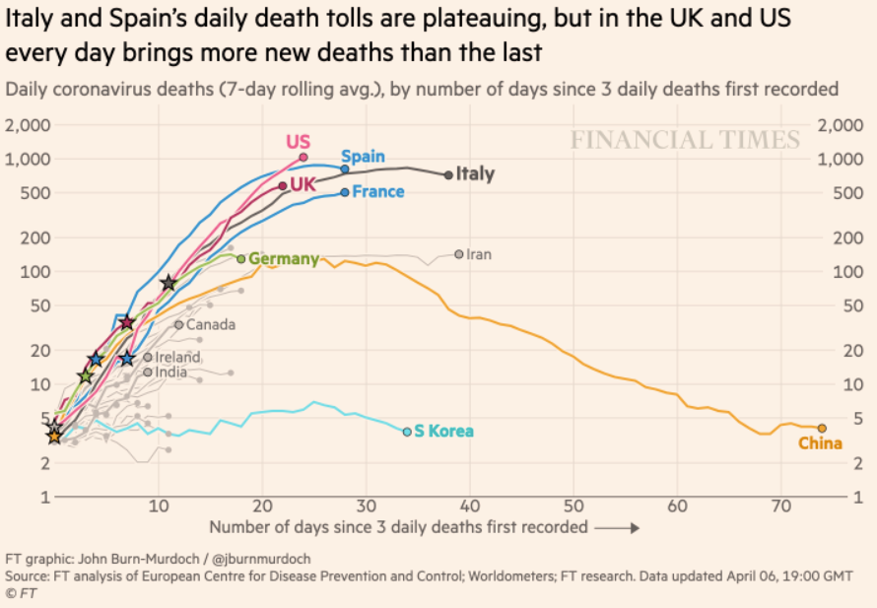
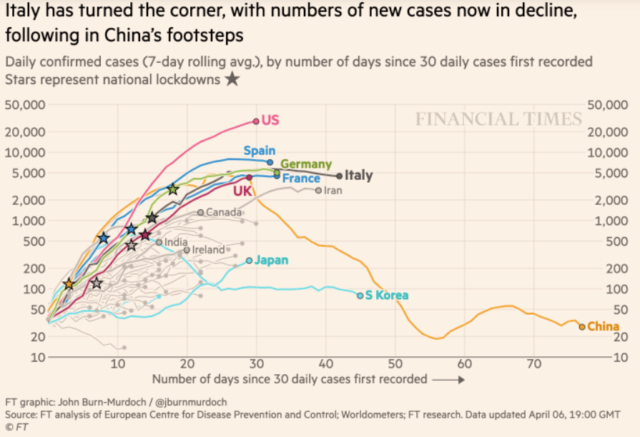
Financial Times Graphs Blown Up…

Slide 12
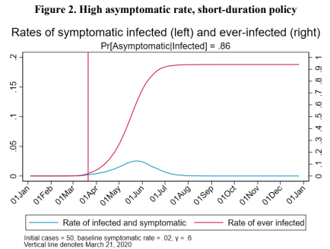
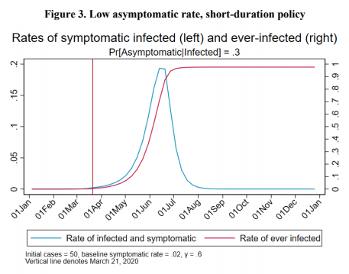
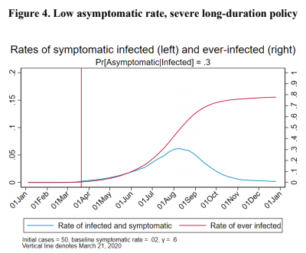
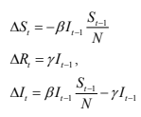
James Stock (2020)
Standard SIR model:<https://drive.google.com/file/d/12MV466ZZy5xHir4xdPhoTrL1oO8CbZU-/view>:
Susceptible, Infected, Recovered (& immune), transmission rate β, recovery rate γ, reproduction number R0, asymptomatic hence non-tested rate π0
Calibration: half-life of infection one week: γ = 0.5, s0 = 0.02, 50 cases on Jan 24
For March 21, 2020, the positive test rate in the United States is approximately 10%…
<https://drive.google.com/file/d/12MV466ZZy5xHir4xdPhoTrL1oO8CbZU-/view>

Slide 17
Bringing the Economy Back Up from Anæsthesia
Major issues:
Certificates of immunity:
Which requires test, test, test:
And not just disease virus tests
Presence-of-antibodies tests
How quickly can we match the immune with public-contact jobs?
What jobs can be done with minimal infection risk?
What minimal-infection substitutes can we find for previous jobs?
How quickly can restrictions be relaxed without the virus coming roaring back?
How do we avoid having the market give a “shutdown” signal to enterprises we in fact want restarted?
Which is pretty much all of them
How much of the potential caseload do we want to push out beyond the vaccine-arrival date?
ALL THESE QUESTIONS ARE ANSWERABLE IF WE LEARN THE ASYMPTOMATIC HENCE NON-TESTED RATE!!

Slide 18
Keeping the Economy from Crashing During the Lockdown
Nick Rowe: We have a 50% output cut in 100% of the sectors:
A temporary 100% output cut in 50% of the sectors (what the Coronavirus does) is very different from a 50% output cut in 100% of the sectors
Nick’s thought experiment:
In three months we are going to invent unobtanium:
Substantial intertemporal substitutibility
Plus lower cross-good contemporaneous substitutitbility
Hence high desired savings rate now
Flex-price market thus produces a nominal rate at the zero lower bound and a high inflation rate over the next three to six months
Plus liquidity-constrained workers in affected sectors see their demand go to zero immediately
Can we get there? Should we get there? What should we do instead?
We need a good RBC economist: are there any?…
<https://worthwhile.typepad.com/worthwhile_canadian_initi/2020/03/relative-supply-shocks-unobtainium-walras-law-and-the-coronavirus.html>

Slide 19
Keeping the Economy from Crashing During the Lockdown II
Nick Rowe:
<https://worthwhile.typepad.com/worthwhile_canadian_initi/2020/03/relative-supply-shocks-unobtainium-walras-law-and-the-coronavirus.html>
Plus: to extend the thought experiment:
We just lost the ability to make “unobtainium”
So we should be substituting leisure for work, and moving workers into relatively unproductive labor, making the commodities we can still produce right now
How should relative prices move as a result? How should we make them move?
Plus: distributional issues
Plus: bankruptcy and credit chain issues

Slide 20
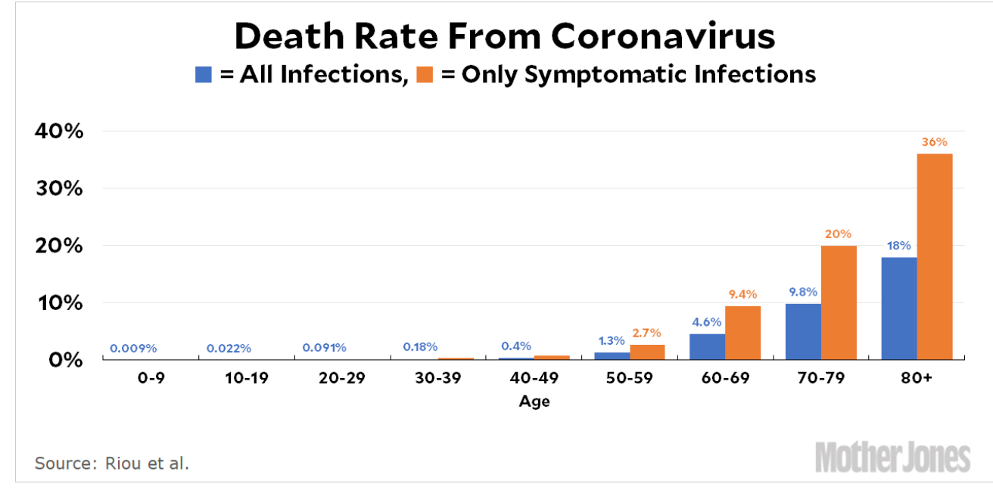
MOAR Coronavirus!
Death for Geezers!
Mortality for the Youngs very low…
It’s the flu for them—for you…
And an extra doubling—or is it 5%?—mortality for the asthmatic
And an extra doubling—or is it 5%?—mortality for the overweight

Slide 21
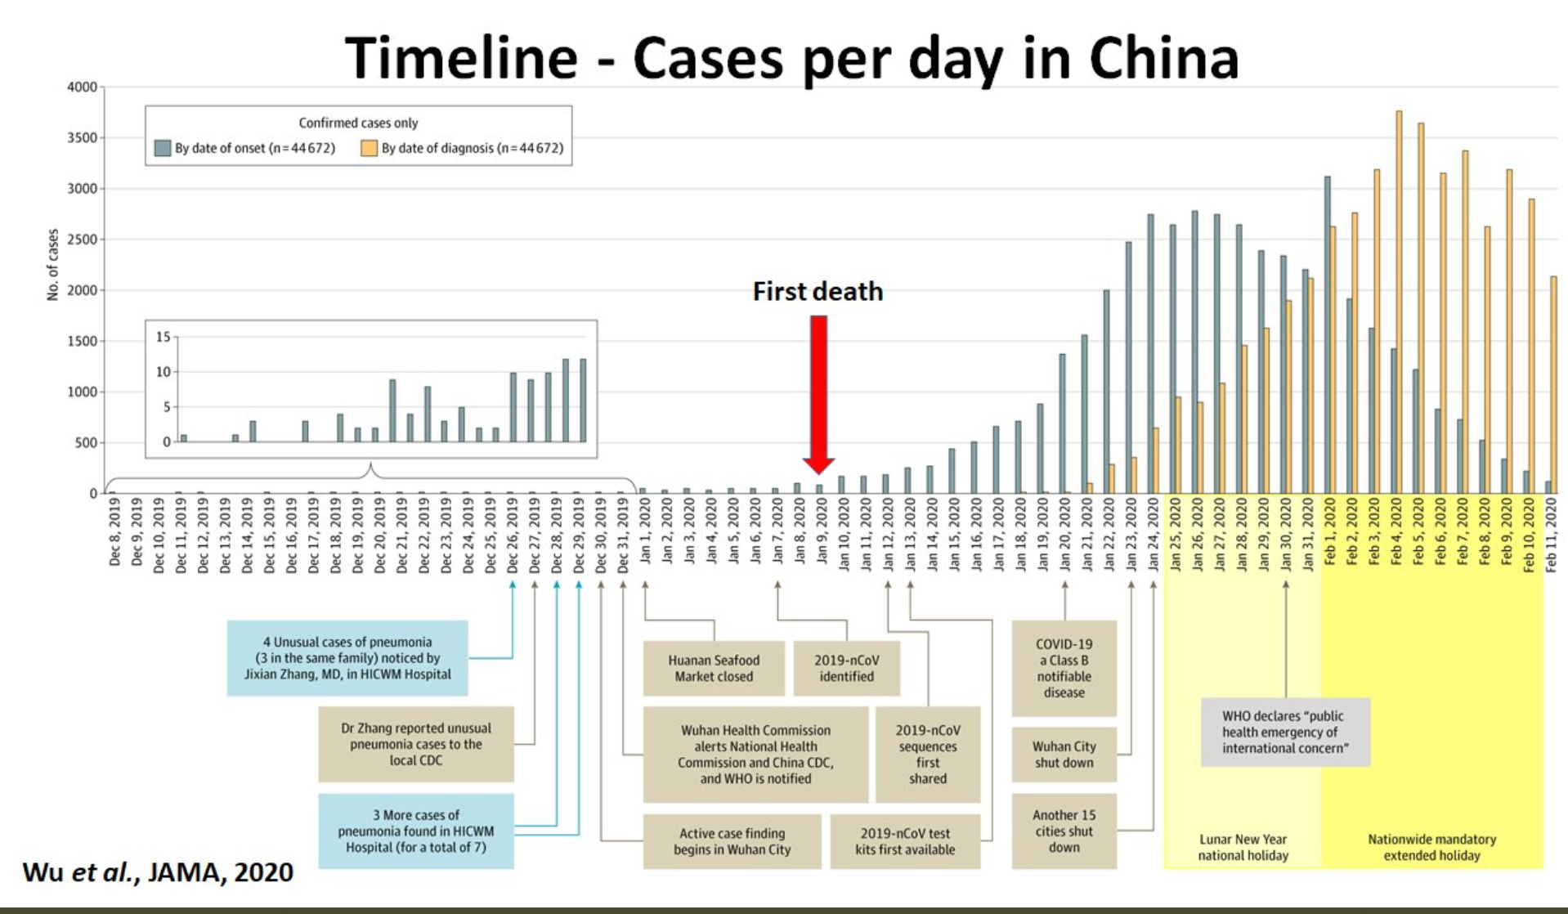
What We Think Happened in Wuhan
China beat it quickly & relatively easily!
We think
Shut down Wuhan when 200 cases per day
That seems to have been a good decision

Slide 22

The Goal
When Is It Appropriate to Move on This?
Immediate social distancing…
Self-isolate if you have a cough and a fever…
Hope that warmer temperatures will do to this what they did to SARS…
Otherwise, when do you want to start spreading out transmission. It seems that early is as good as later, so do it early…
I have no good intuition on why you want to move early
Plus your moving early will be wasted if you get reinfected
Plus the sparks you throw off making others’ lives more difficult

Slide 23
References
Financial Times (2020): Coronavirus Tracked: The Latest Figures as the Pandemic Spreads <https://www.ft.com/coronavirus-latest>
Nick Rowe (2020): Relative Supply Shocks, Unobtainium, Walras' Law, and the Coronavirus <https://worthwhile.typepad.com/worthwhile_canadian_initi/2020/03/relative-supply-shocks-unobtainium-walras-law-and-the-coronavirus.html>
Jim Stock (2020): Coronavirus Data Gaps and the Policy Response <https://drive.google.com/file/d/12MV466ZZy5xHir4xdPhoTrL1oO8CbZU-/view>

Slide 24
MOAR Coronavirus!
What I am watching:
Max Roser & Hannah Ritchie: Coronavirus Disease (COVID-19) <https://ourworldindata.org/coronavirus>…
Worldometer: Coronavirus Update (Live) <https://www.worldometers.info/coronavirus/>: ‘125,599 Cases and 4,605 Deaths from COVID-19 Virus Outbreak…
FT Coronavirus Tracker <https://www.ft.com/content/a26fbf7e-48f8-11ea-aeb3-955839e06441>
Josh Marshall’s COVID Twitter List <https://twitter.com/i/lists/1233998285779632128>
NEJM Group: Updates on the Covid-19 Pandemic <http://m.n.nejm.org/nl/jsp/m.jsp?c=%40kxNtXckRDOq8oG0jJvAXsIzN4mPECIPhltxoTSdTU9k%3D&cid=DM89089_NEJM_COVID-19_Newsletter&bid=173498255>: 'From the New England Journal of Medicine, NEJM Journal Watch, NEJM Catalyst, and other trusted sources...

Slide 25
Catch Our Breath…
Ask a couple of questions?
Make a couple of comments?
Any more readings to recommend?
<https://www.icloud.com/keynote/0YKEi7HeOrVGvKYtt9FEqH7nA>
<https://www.bradford-delong.com/2020/04/coronavirus.html>
github:<https://github.com/braddelong/public-files/blob/master/coronavirus.pptx>
https://github.com/braddelong/public-files/blob/master/coronavirus.pdf>
html File: <https://www.bradford-delong.com/2020/04/coronavirus.html>
Edit This File: <https://www.typepad.com/site/blogs/6a00e551f08003883400e551f080068834/post/6a00e551f080038834025d9b3bd66a200c/edit>
<https://delong.typepad.com/files/2020-04-01-coronavirus.pdf>

Slide 26
Coronavirus! (March 16)
With 31 deaths in the U.S. as of March 11, a 1% death rate, and up to 4 weeks between infection and death, that means that as of Feb 12 there were 3100 coronavirus cases in the United States.
With 87 deaths in the U.S. as of Mar 16, a 1% death rate, and up to 4 weeks between infection and death, that means that as of Feb 17 there were 8700 coronavirus cases in the United States
If it is doubling every seven days, then now about 150,000 people have and in the next week about 150,000 more people in the U.S. will catch coronavirus—which means 1/2200, currently 3500 of the 7.6 million inhabitants of San Francisco Bay. Touch a hard surface that any of those 3500 has touched in the last 48 hours, and the virus has a chance to jump to you…
These numbers could be five times too big. These numbers are probably not five times too small unless the thing is a lot less deadly, and there are a lot of asymptomatic cases…
What is wrong with this analysis?

Slide 27
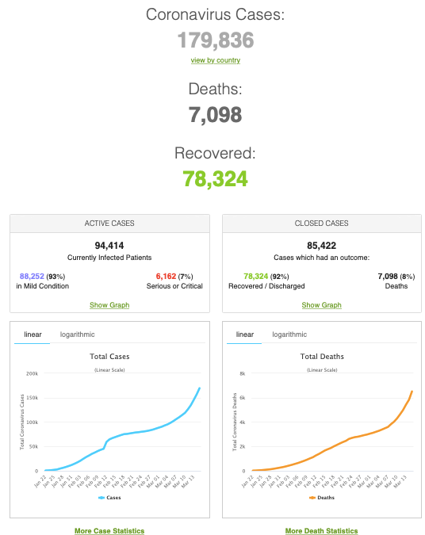
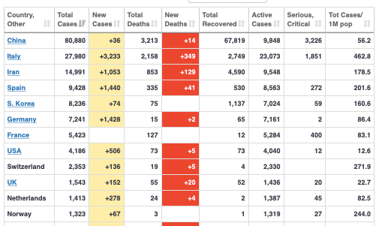
MOAR Coronavirus!
As of March 21: Things are not moving in the right direction:
What is the R0?
How can the R0 be changed?
How will the R0 change?
What is the asymptote share of the population?
What is the mortality rate?

Slide 28
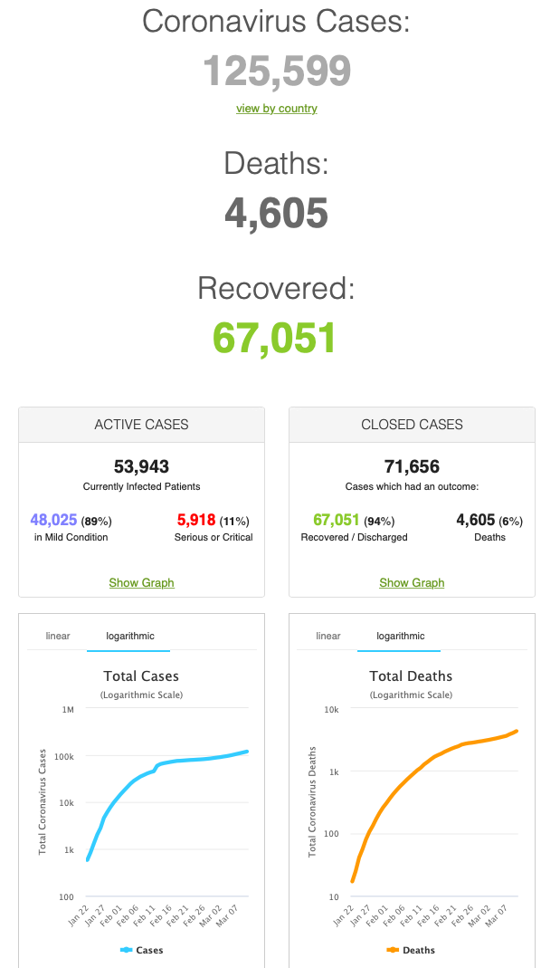
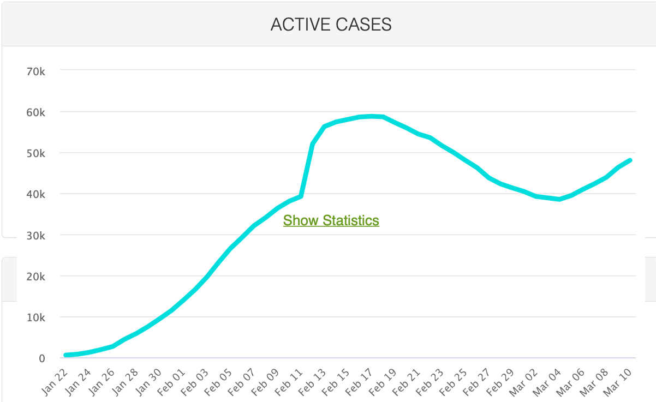
MOAR Coronavirus!
As of March 10: Things are not moving in the right direction:
What is the R0?
How can the R0 be changed?
How will the R0 change?
What is the asymptote share of the population?
What is the mortality rate?

Slide 29
Notes

Slide 30
Roadmap for the Next Two Weeks…
6. Policy Issues
22. Th Apr 16: 6.1. "Deep Roots" vs. Path Dependence
Read Before: Nathan Nunn (2012): Culture and the Historical Process <https://delong.typepad.com/files/nunn-culture.pdf>
Read Before: Melissa Dell (2015): Path Dependence in Development: Evidence from the Mexican Revolution <https://scholar.harvard.edu/files/dell/files/revolutiondraft.pdf>
Slides: <https://github.com/braddelong/public-files/blob/master/econ-135-lecture-22.pptx>
23. Tu Apr 21: 6.2. Growth and Fluctuations; Trade and Development, Foreign Aid
Read Before: Barry Eichengreen (2015): Hall of Mirrors: The Great Depression, The Great Recession, and the Uses-and Misuses-of History, selections <https://delong.typepad.com/files/eichengreen-mirrors.pdf>
Read Before: David Atkin (2014): Endogenous Skill Acquisition and Export Manufacturing in Mexico <https://delong.typepad.com/files/atkin-skill.pdf>
Slides: <https://github.com/braddelong/public-files/blob/master/econ-135-lecture-23.pptx>
24. Th Apr 23: 6.3. Populism, Plutocracy, Kleptocracy, & Neo-Fascism
Read Before: Ernest Gellner (1973): Nations & Nationalism, selections <https://delong.typepad.com/files/gellner-nations.pdf>
Read Before: Barry Eichengreen (2018): The Populist Temptation Economic Grievance & Political Reaction in the Modern Era, selections <https://delong.typepad.com/files/eichengeeen-populist.pdf >
25. Tu Apr 28: 6.4. Global Warming
Read Before: Melissa Dell et al. (2012): Temperature Shocks & Economic Growth: Evidence from the Last Half Century <https://scholar.harvard.edu/files/dell/files/aej_temperature.pdf>
Read Before: Melissa Dell et al. (2014). What Do We Learn from the Weather? The New Climate-Economy Literature, selections <https://economics.mit.edu/files/9138>

Slide 31
Roadmap Following…
Th Apr 30: 6.5. The Pace and Meaning of Economic Growth
Read Before: William Nordhaus: Do Real-Output and Real-Wage Measures Capture Reality? <https://www.nber.org/chapters/c6064.pdf>
Read Before: John Maynard Keynes: Economic Possibilities for Our Grandchildren<<https://delong.typepad.com/files/keynes-persuasion.pdf>
Read Before: Edward Bellamy (1887): Looking Backward 2000-1887, selections <https://delong.typepad.com/files/bellamy-backward.pdf>
7. Conclusion
Tu May 5: 7. Conclusion: The Future?
Read After: Robert Allen (2011): Global Economic History: A Very Short Introduction, selections <https://delong.typepad.com/files/allen-geh.pdf >
W May 13 11:30-14:30: FINAL PAPER/PROJECT DUE

Slide 32
Discussion
African Retardation:
What strikes you as important here?

Slide 33
Africa
Tu Apr 14: 5.4.2. Africa:
Read Before: Nathan Nunn (2008): The Long Term Effects of Africa's Slave Trades <https://github.com/braddelong/public-files/blob/master/readings/article-nunn-long-term.pdf>
Slides: <https://github.com/braddelong/public-files/blob/master/econ-135-lecture-21b.pptx>
Discussion Thread: <>
Zoom Q&A Session: <>

Slide 34
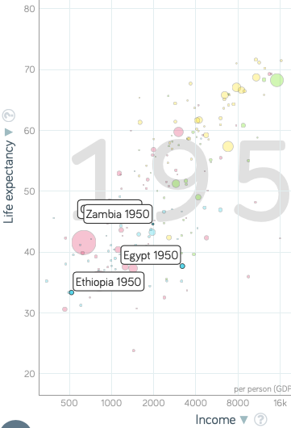
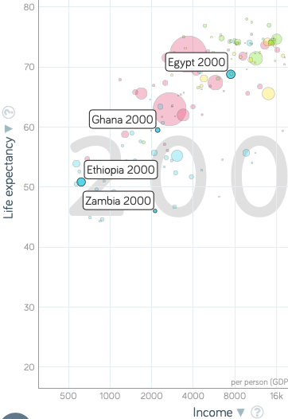
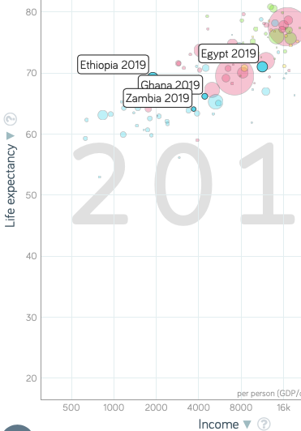
Africa Falls Behind, 1950-2000
The rest of the global south passes Africa between 1950 & 2000:
Most African countries have respectable—not global north but respectable—levels of prosperity in 1950
They do get richer from 1950-2000
But by 2000 their levels of prosperity are no longer respectable for the global south
With the exception of the Maghreb
After 2000 Africa gets into growth gear
But “African retardation” vis-a-vis south & east Asia & Latin America was not a thing in 1950
It is a creation of the post-WWII half century
4:00

Slide 35
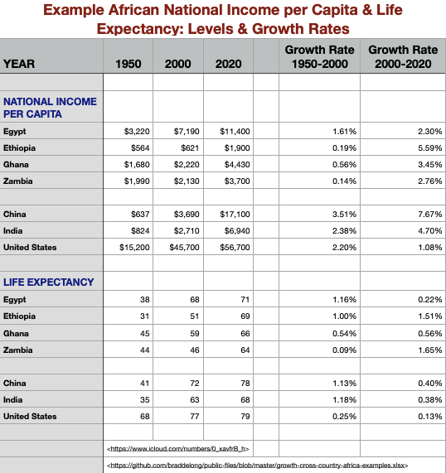
Africa Falls Behind, 1950-2000
Four example African countries:
Egypt (north, Maghreb), Ethiopia (east, poor), Ghana (west, well-integrated economically), & Zambia (south, industrializing)
Zambia, Ghana richer than Portugal in 1950
Egypt does not converge, but it grows along with the world from 1950-2000
The other three? Not
Substantial 1950-2000 improvements in life expectancy & other social indicators, however
What changes for good for Africa in 2000?
4:00

Slide 36
African Institutional Development
Sub-Saharan Africa comes late to state-building:
“Stateless” societies were still common in Africa until after WWII:
Somalia
The Nuer in South Sudan
The Tallensi in northern Ghana
The Hadza of Tanzania
The San in Botswana
Philip Curtin: In 1890 a quarter of Africans in “stateless” societies
Early 1400s: Kongo, Loango, Tio, Luba, Rund
Since 1000: Ghana, Mali, Songhay
Great Zimbabwe?
Nubia, Kush, Axum
Why might African political centralization have been delayed?:
Diamond: Lack of wheat, rice, corn agricultural staples for intensive agriculture—hence low population density
Adverse disease environment?
Vansina/McIntosh: unique sub-Saharan African sociological matrix inhibits centralization
4:00

Slide 37
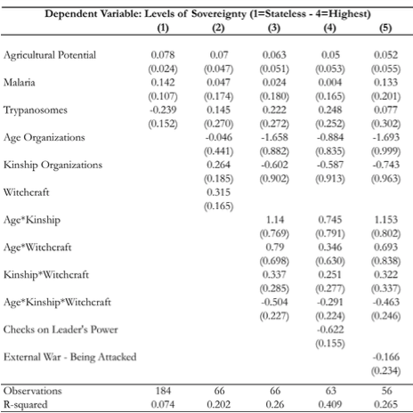
Within Sub-Saharan Africa Correlations
James Robinson: what determines a society’s “level of sovereignty” within Africa?:
Not correlated with agricultural potential
Not correlated with disease burden
Correlated with population density
Social network ties & belief structures?
Little robustness
(age) x (kinship) x (witchcraft)
Is sub-Saharan Africa in the agrarian age a success? Society successfully resisting the state?
4:00

Slide 38
I Samuel 8:4 ff.
All the elders of Israel gathered themselves together, and came to Samuel unto Ramah:
And said unto him, “Behold, thou art old, and thy sons walk not in thy ways: now make us a king to judge us like all the nations.”…
And Samuel told all the words of the Lord unto the people that asked of him a king. And he said:
“This will be the manner of the king that shall reign over you: He will take your sons, and appoint them for himself, for his chariots, and to be his horsemen; and some shall run before his chariots. And he will appoint him captains over thousands, and captains over fifties; and will set them to ear his ground, and to reap his harvest, and to make his instruments of war, and instruments of his chariots. And he will take your daughters to be confectionaries, and to be cooks, and to be bakers.
“And he will take your fields, and your vineyards, and your oliveyards, even the best of them, and give them to his servants. And he will take the tenth of your seed, and of your vineyards, and give to his officers, and to his servants. And he will take your menservants, and your maidservants, and your goodliest young men, and your asses, and put them to his work.
“He will take the tenth of your sheep: and ye shall be his servants.
“And ye shall cry out in that day because of your king which ye shall have chosen you; and the Lord will not hear you in that day…”
4:00

Slide 39
Slavery in Africa
Slavery & thralldom common in human history:
Steal people, rip them out of their social context, and sell them to foreigners
Then, without social ties or orientation, they can be treated worse than poor third cousins
Or things can get much nastier: galleys, mines, plantations
Genesis 37:23 ff.:
When Joseph was come unto his brethren, that they stript Joseph… and cast him into a pit…. And, behold, a company of Ishmeelites came from Gilead with their camels bearing spicery and balm and myrrh, going to carry it down to Egypt. And Judah said unto his brethren, “What profit is it if we slay our brother, and conceal his blood? Come, and let us sell him to the Ishmeelites, and let not our hand be upon him; for he is our brother and our flesh.” And his brethren were content…. They drew and lifted up Joseph out of the pit, and sold Joseph to the Ishmeelites for twenty pieces of silver: and they brought Joseph into Egypt…. And the Midianites sold him into Egypt unto Potiphar, an officer of Pharaoh's, and captain of the guard…”
4:00

Slide 40
Slavery in Africa II
Slave trades in the past millennium:
“Black Sea”
“Barbary Coast”
Indian Ocean
Atlantic-Caribbean
Two moments at which slavery rapidly intensified:
Coming of the slavery-driven “Atlantic economy” after 1600
Abolition of the slave trade, followed by redeployment of slaves into African plantations to grow export agricultural crops
30% of western Sudanese slaves in 1900? Slavery “abolished” in Sierra Leone in 1928, in Nigeria in 1936, in Mauritania in 1981
Slave trades: Atlantic1600-1850: 13M? Indian Ocean 1000-1900: 5M? Internal African 1500-1900: 5M? Trans-Saharan 1200-1900: 3M? Barbary Coast 1500-1800: 1.5M? Black Sea 1400-1750: 3M?
Population of Africa in 1700: 60M?
People born in Africa & surviving to age 5, 1500-1800: 360M?
4:00

Slide 41
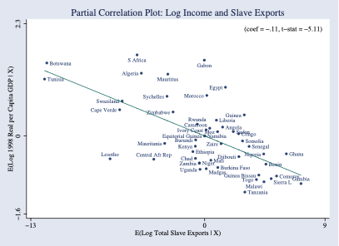
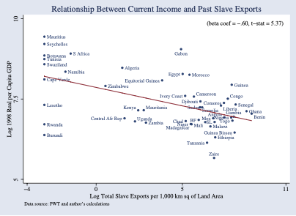
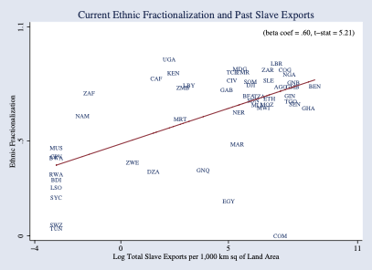
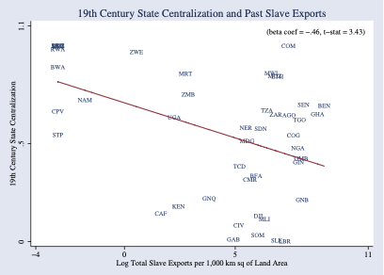
Consequences
Societal disintegration:
Nathan Nunn has constructed estimates:
The negative effects of the slave trade on income per-capita in Africa.
Shipping records, plantation records, sales receipts, the ethnicity/origin of slaves
Intensity of slaving negatively correlated with income today
Intensity of slaving negatively correlated with institutional quality.
A fall of one standard deviation in the extent of slaving raises income per capita by 50%
4:00

Slide 42
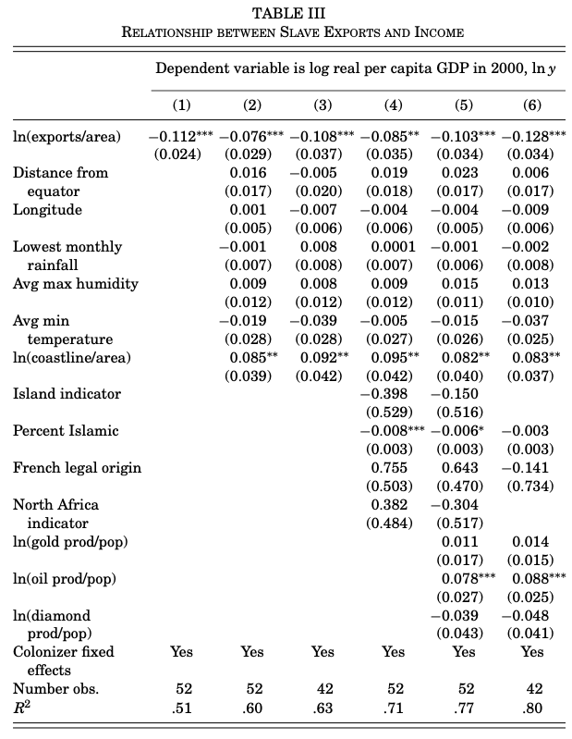
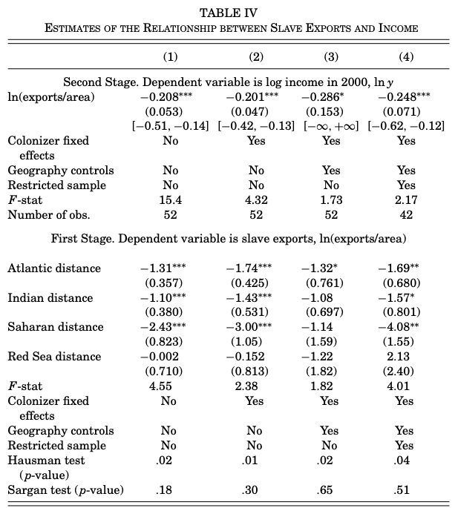
Regression Results
4:00

Slide 43
Why Trade Slaves?
Astonishingly “Inefficient”:
20% of captives died en route between Africa and the Americas.
Far more died in the violence of capture or on the way to be sold
(Joseph Miller estimated that 50% of the slaves caught in the interior of Angola died before being sold at the coast
Low African population density
Slavery worthwhile by elites to avoid paying high wages
But that means slaves would have been very productive kept in Africa
(Slave exports from Bali, and the 1815 Mt. Tambora explosion)
Lack of centralized states meant maintaining domination not easy
Sell slaves to Europeans, & maintaining domination then becomes their problem
4:00

Slide 44
How European Colonialism Underdeveloped Africa
Walter Rodney’s work:
Contra what Dell calls the “eccentric consensus”: colonial officials and academics such as Peter Bauer and Niall Ferguson agree with Marxists like Lenin and Bill Warren’s Imperialism: Pioneer of Capitalism that colonialism stimulated economic growth in Africa:
Modern institutions and organizational forms…
Technologies such as railways and mines…
Integration into increasingly globalized world economy
Research into curing “tropical” diseases…
But: resource expropriation
Melissa Dell’s calculation of the effects of the Natives Land Act of 1913 in South Africa
Expropriating 93% of the land
For a wage share of 2/3, generates a 59% decline in African living standards
To some degree elite replacement, but still…
4:00

Slide 45
Balance of the Evidence
Pre-colonial polities, European settlement, all other:
Pre-colonial polities: colonialism stopped the existing dynamics of centralization, severed links of accountability (indirect rule) and in many cases created/intensified conflict
Large-scale European settlement: mass immizerization associated with land expropriation, creation of huge inequalities, institutionalized racism
Others: European contact brings much greater social connectivity and economic integration
But was colonialism the best way to do that?
Johannes Fedderke & al.: colonialism does not bring higher-quality property rights
4:00

Slide 46
Colonialism: Ghana
The Asante as a “martial race”:
Asante chiefs were made into the tools of indirect rule.
Post-independence politics dominated by Nkrumah and an anti-Asante coalition initiating a cycle of anti-Asante and pro-Asante regimes. Today the two main political parties revolve around this cleavage.
The fight for power after 1957 led to political instability, coups, military rule, the expropriation of the cocoa farmers. The nature and structure of this conflict was entirely a legacy of the colonial state.
A plausible counter-factual is that Asante would have expanded and formed a “nation state”. This might not have been developmental, but it would have avoided indirect rule and the political instability which undermined the economy.
Economic growth during the colonial period was a purely African development which would plausibly have occurred without British intervention (Hill, 1963, Austin, 2005).
The allocation and regulation of land were made less efficient by indirect rule (Colson, 1971, Goldstein and Udry, 2008).
Location of infrastructure was determined by the desire to rule as much as develop and the only reason that Asante had not previously built a railway to the coast was because the British colonial office had blocked it (Chaves, Engerman and Robinson, 2012).
Missionaries were the driving force behind educational expansion in British colonies and a reasonable counterfactual is that absent colonization the missionaries would have come anyway.
4:00

Slide 47
Institutions: Sierra Leone
In 1787 Freetown founded
Home for London’s ‘Black poor’ and repatriated slaves
After 1807 Freetown was an important base for the British anti-slave trade squadron
No large centralized state like the Asante Empire
In the second half of the 19th century the interior was expropriated by the British via a sequence of treaties with individual chiefs
Frederick Cooper proposed the notion of the ‘Gatekeeper State’ in Africa - colonial powers sat on the coast and developed the minimal amount of infrastructure necessary to keep order and extract natural resources: Sierra Leone looks like a good example for him:
Indirect rule and Paramount Chiefs
The British often interfered with the legitimacy of the traditional powerholders.
Instead of their authority coming from the people, the authority of chiefs now came from the colonial state
Severed linkages between the chiefs and their people
Extraction of taxes and unpaid labor on the farms of chiefs increased as a result
4:00

Slide 48
After Independence: Sierra Leone
In 1961 British handed power to Sir Milton Margai and his Sierra Leone People’s Party (SLPP):
Support primarily in the South (Mendeland) and East
In 1967 the SLPP narrowly lost a hotly contested election to Siaka Stevens’ All Peoples Congress party (APC).
Anti-Stevens military coup led by Mende officers (who dominated the higher ranks of the military)
Pro-Stevens counter-coup led by northern junior officers
Siaka Stevens: President of Sierra Leone 1967-1985
Favorite Aphorism—“The cow eats where it’s tethered”
Pull up the railroad to isolate and undermine the economy of the East and the rural support for the SLPP.
But this also crippled the coffee farmers
One-party state
Patrimonial and violent: Sam Bangura—Governor of the Central Bank—was thrown off the roof
The economy and state collapsed
Paramount Chiefs as local despots:
Must come from ruling families
More ruling families, more potential political competition
Moving from 1 ruling family to the mean of 4:
increases literacy by one standard deviation, or 6 percentage points
increases non-agricultural employment by 1 percentage point, from a base of only 3 percent
4:00

Slide 49
Big Ideas: Lecture 21b: African Retardation
Takeaways from this class:

Slide 50
Catch Our Breath…
Ask a couple of questions?
Make a couple of comments?
Any more readings to recommend?

Slide 51
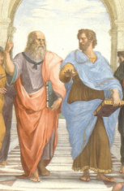
Notes, etc.…

